Slide 1

FABRICATION OF THREE DEGREES OF FREEDOM ROBOTIC ARM
A Project
Submitted in the partial fulfillment of the requirement for the award of the degree of
Bachelor of Technology
in
Mechanical Engineering
By
I.RAJESH 186N1A0323
G.HARI TEJA 186N5A0316
A.S.NETHI KONDA 186N1A0302
B.RAKESH 186N1A0306
N.VASU 186N5A0337
Under the Guidance of
Mr. D.PAVAN KUMAR
Assistant Professor
SRINIVASA INSTITUTE OF ENGINEERING & TECHNOLOGY

Slide 2
List of contents
Abstract
Introduction
Functions of Robotic Arm
Methodology
Components
Introduction to PRO/E
Results
Applications and Advantages
Working video
Conclusion
References

Slide 3
ABSTRACT
The project discusses the design and fabrication of a pick and place robotic arm. The robotic arm is intended for educational purposes. In this project we are designing the robotic arm for improved accuracy by using servos to power the joints in the robotic arm. We are designing the robotic arm using Pro/Engineer software. In this project we are going to fabricate robotic arm which performs the pick and place operation. The project covers the procedure for selection of the servos used to power each joint of the arm in details. We are selecting plastic to fabricate the components of the robotic arm. Selecting a suitable servo controller and control software for the Robotic arm is developing using Microsoft’s C programming language.

Slide 4
INTRODUCTION
The first usage of the word ‘robot’ was in a 1921 Czech science fiction play – ‘Rossum’s Universal Robots’ – by Karel Capek. The robots were artificial people or androids and the word was derived from the word ‘Robata’, a Czech word for slave. A question of perpetual interest is to define a robot. Since the beginning of the study of robotics, there has been some controversy in the definition of a robot. So long as the evolution of robotics continues, the definition of the robot will change from time to time, depending on the technological advances in its sensory capability and level of intelligence. However, the most widely accepted definition of a robot was given by the Robotic Institute of America (RIA) in 1979. Robotic manipulators resembling the human arm is known as robotic arms. They are constructed by a structure consisting of structurally robust links coupled by either rotational joints or translating joints. A robotic arm is thus a type of mechanically coupled or joined arm, run by programmable commands, with similar functions to a human arm. It may be the sum total of the mechanism links or may be part of a more complex sized robot.

Slide 5
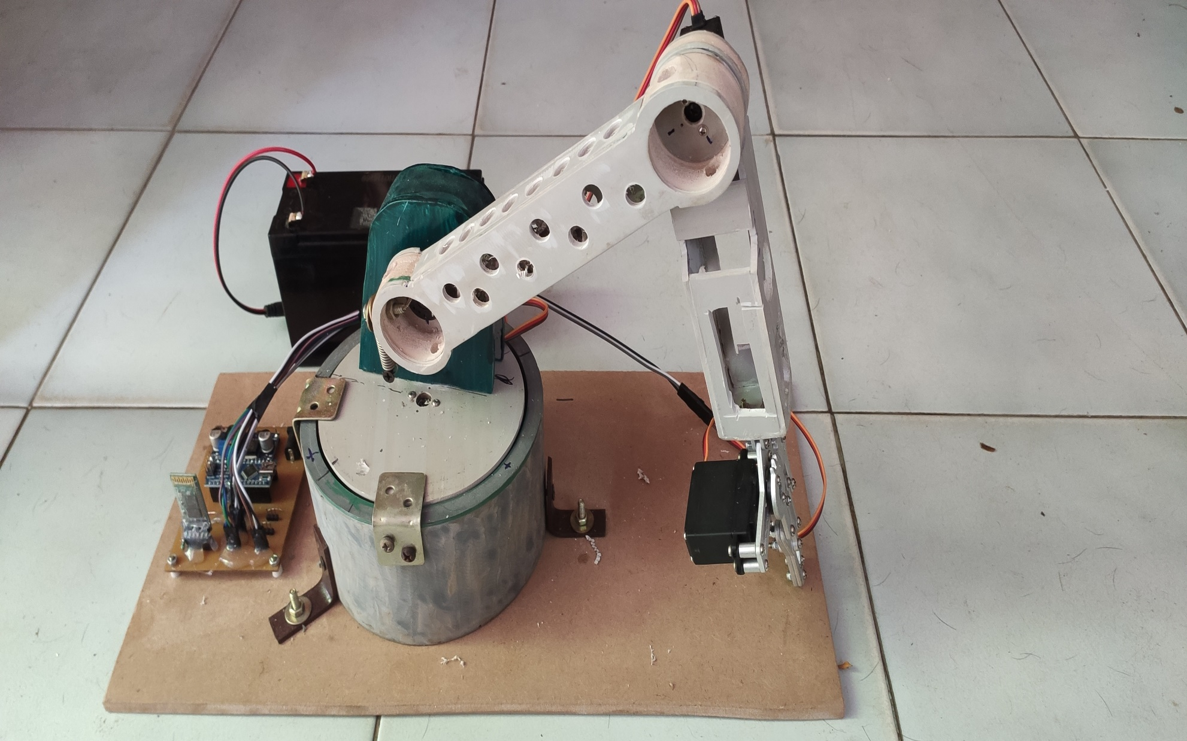

Slide 6
Functions of the Robotic Arm:
This work is able to successfully accomplish the defined functionality. A sample robot which can rotate, magnetize an object, lower and raise its arm, by being controlled by the ESP 32 There are four buttons being controlled by the control unit at the base of the arm:
1) ON/OFF: the ON button puts on the system while the OFF button puts off the system
2) START/STOP: the START button starts the movement of the whole arm from its reset point, while the STOP button takes the arm back to its reset button after completion of its movement.
3) RIGHT-LEFT/LEFT-RIGHT: when this button is switched to the RIGHT-LEFT part it causes movement from right to left, while the LEFT-RIGHT part causes movement from left to right.
4) 4.180/90: when the button is on 180, it causes a rotation of 180 degree of the base stepper motor, but when put on 90 degrees, it causes rotation of 90 degrees.
DESIGN PROCEDURE FACTORS TO BE CONSIDERED
The various factors to be considered while designing of pick and place robots are been discussed as follows. The factors are all important while designing procedure of the robot.

Slide 7
Methodology
Study the literature review
Selection of materials
Getting Started With Arduino Board
Download The Application
Code Working
Results& Comparison

Slide 8
COMPONENTS
ARDUINO NANO
BATTERY
SERVO MOTORS
HC-05
GRIPPER
SWIVEL BASE

Slide 9
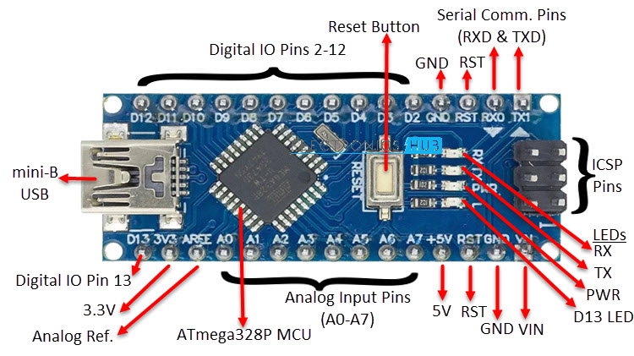
ARDUINO NANO
The Arduino Nano is a small, complete, and breadboard-friendly board based on the ATmega328 (Arduino Nano 3.x). It has more or less the same functionality of the Arduino Duemilanove, but in a different package. It lacks only a DC power jack, and works with a Mini-B USB cable instead of a standard one.
SPECIFICATIONS:
MICROCONTROLLER : ATmega328
OPERATING VOLTAGE : 5 V
INPUT VOLTAGE : 7-12V
DIGITAL I/O PINS : 22 (6 of which are PWM)
ANALOG IN PINS : 8
DC CURRENT PER I/O PINS : 40 mA (I/O Pins)
FLASH MEMORY : 32 KB of which 2 KB used by
boot loader
SRAM : 2 KB
CLOCK SPEED :16 MHz
EEPROM :1 KB

Slide 10
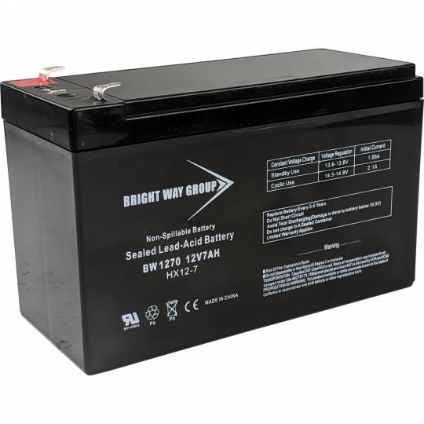
Battery
An electric battery is a source of electric power consisting of one or more electrochemical cells with external connections for powering electrical devices. When a battery is supplying electric power, its positive terminal is the cathode and its negative terminal is the anode.
Voltage : 12 Volt
Capacity : 7 Ah
Type : Sealed Lead Acid
Length : 5.95"
Width : 2.56"
Height : 3.71"

Slide 11
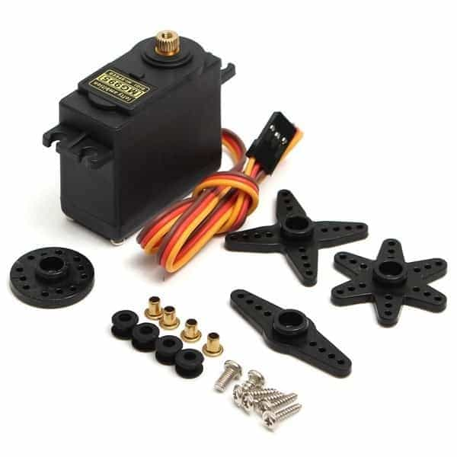
SERVO MOTOR (MG995)
Servo motors (or servos) are self-contained electric devices that rotate or push parts of a machine with great precision.
SPECIFICATIONS:
Weight: 55 g
Dimension: 40.7 x 19.7 x 42.9 mm approx.
Stall torque: 8.5 kgf·cm (4.8 V ), 10 kgf·cm (6 V)
Operating speed: 0.2 s/60º (4.8 V), 0.16 s/60º (6 V)
Operating voltage: 4.8 V a 7.2 V
Dead band width: 5 µs
Stable and shock proof double ball bearing design
Temperature range: 0 ºC – 55 ºC

Slide 12
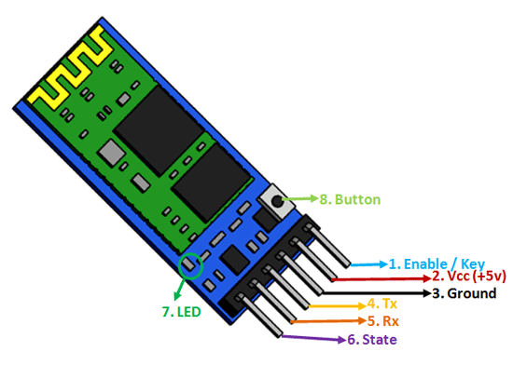
HC-05
HC-05 Bluetooth Module is an easy to use Bluetooth SPP (Serial Port Protocol) module, designed for transparent wireless serial connection setup. Its communication is via serial communication which makes an easy way to interface with controller or PC.
SPECIFICATIONS:
Operating Voltage: 4V to 6V (Typically +5V)
Operating Current: 30mA
Range: <100m
Works with Serial communication (USART) and TTL
compatible
Follows IEEE 802.15.1 standardized protocol
Uses Frequency-Hopping Spread spectrum (FHSS)
Can be easily interfaced with Laptop or Mobile phones with Bluetooth

Slide 13
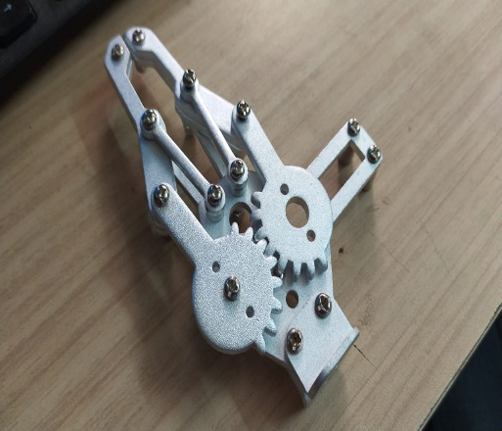
GRIPPER
Robot grippers are an end-of-arm tool (EOAT) responsible for grasping objects. Grippers are an essential part of robotic functionality, especially for material handling and pick and place applications where a robot must reliably pick up and put down parts
SPECIFICATIONS:
Paw material: aluminum alloy
Paw weight: about 68g (without motor)
Claws overall length: 108mm (overall maximum length when closed paw)
Claws overall width: 98mm (maximum overall width of the paw when open)
Paw maximum opening angle: 55mm

Slide 14
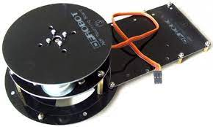
SWIVEL BASE
The swivel base is used for the rotation of the robotic arm
SPECIFICATIONS:
Size : Medium
Material :Copper
Brand :Cloud Robot
Item Weight :0.1 Kilograms
Item Dimensions :1.97 x 1.97 x 1.97 inches

Slide 15
INTRODUCTION TO PRO/E
Pro/ENGINEER, PTC's parametric, integrated 3D CAD/CAM/CAE solution, is used by discrete manufacturers for mechanical engineering, design and manufacturing. Created by Dr. Samuel P. Geisberg in the mid-1980s, Pro/ENGINEER was the industry's first successful parametric, 3D CAD modeling system. The parametric modeling approach uses parameters, dimensions, features, and relationships to capture intended product behavior and create a recipe which enables design automation and the optimization of design and product development processes.
This powerful and rich design approach is used by companies whose product strategy is family-based or platform-driven, where a prescriptive design strategy is critical to the success of the design process by embedding engineering constraints and relationships to quickly optimize the design, or where the resulting geometry may be complex or based upon equations. Pro/ENGINEER provides a complete set of design, analysis and manufacturing capabilities on one, integral, scalable platform. These capabilities, include Solid Modeling, Surfacing, Rendering, Data Interoperability, Routed Systems Design, Simulation, Tolerance Analysis, and NC and Tooling Design.

Slide 16
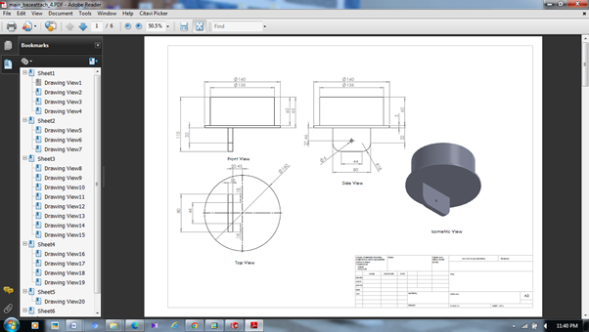
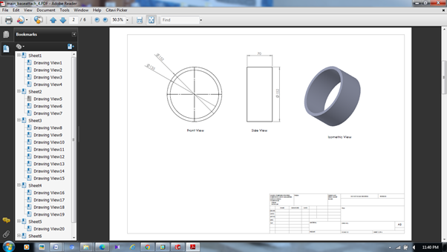
DIMENSIONS OF ROBOTIC ARM

Slide 17
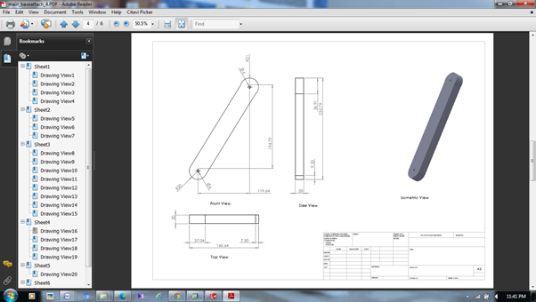
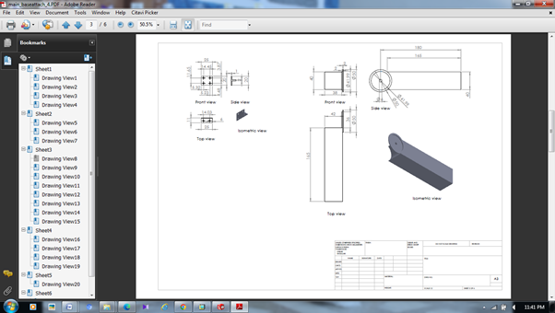

Slide 18
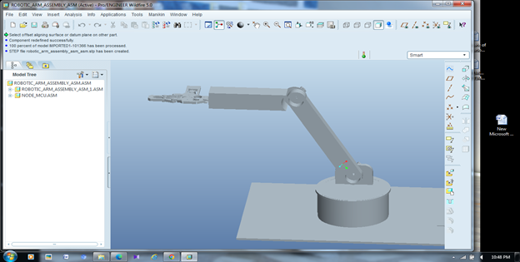
3D Model of Robotic Arm

Slide 19
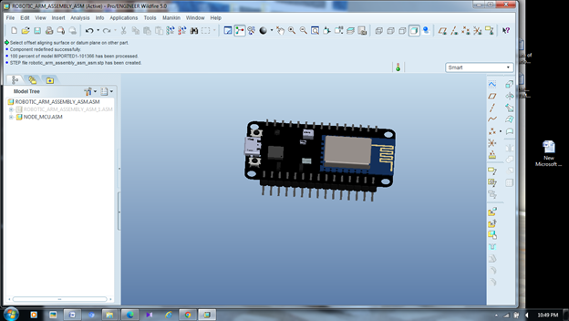
NODE MCU

Slide 20
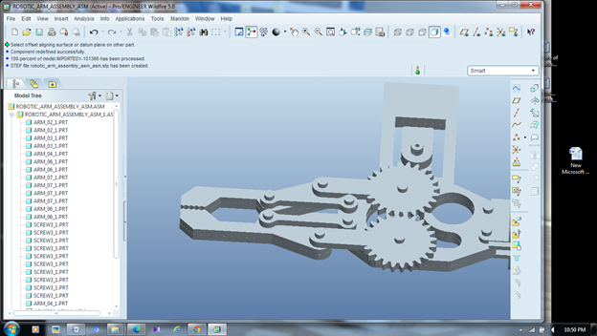
HOLDING JAW

Slide 21
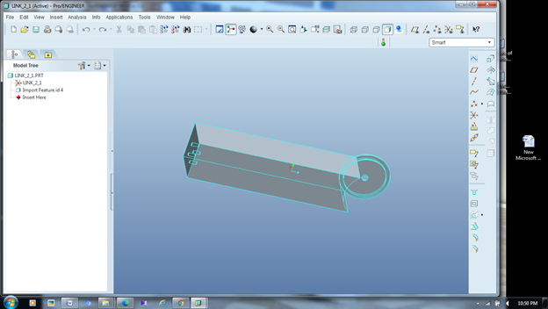
LINK 1

Slide 22
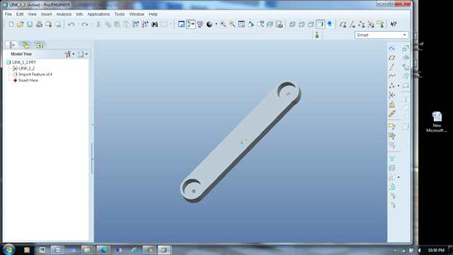
LINK 2

Slide 23
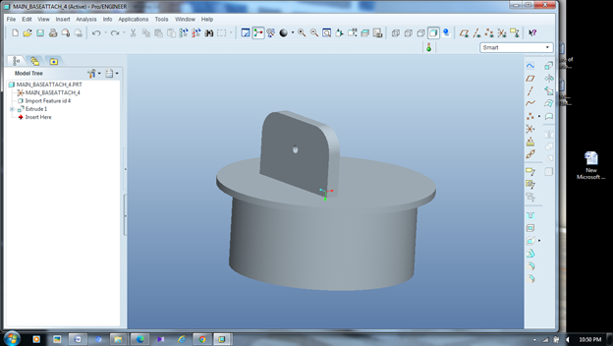
MAIN BASE ATTACH

Slide 24
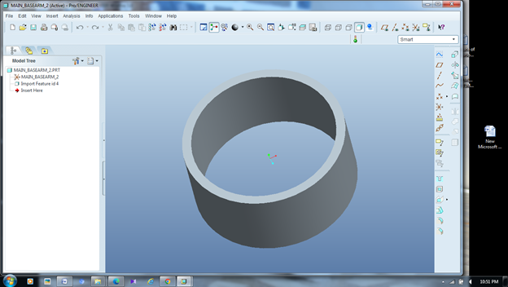
ROTATE ATTACHMENT

Slide 25
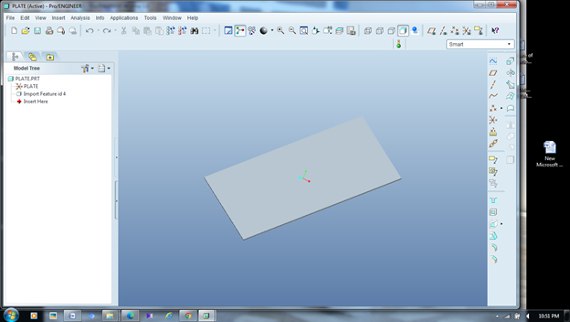
BASE

Slide 26
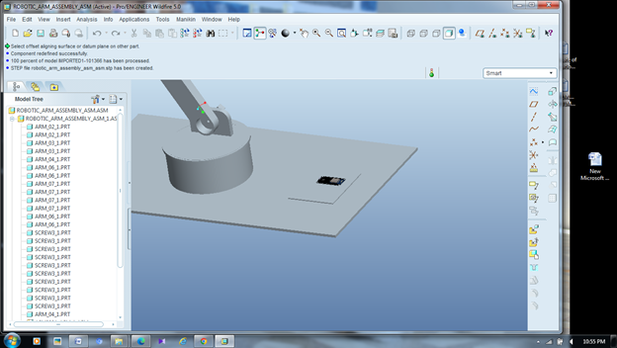
PCB

Slide 27
RESULTS
Mechanical advantages in movement: As metallic servos are used in case of functioning the arm, a servo can work with in the range of angle from 0 to 180 degree. But the program coded in the arduino allows the motor to move at some accurate angle.
Angle | Range
Elbow | 0-120
Wrist | 0-40
Arm | 0-80
Current consumption:
The current consumption depends on the load and the position of the object.
Load | Current consumption(mA)
15gm | Low (0-200)
35gm | Normal (200-500)
45gm | Normal (500-800)
55gm | High (800-900)
75gm | Overloaded (above 900)
95gm | Overloaded (above 900)

Slide 28
SERVO MOTOR TESTING
Servo motor testing is carried out to determine whether the motor is functioning properly or not. The test is carried out on each servo motor at each joint. Servo motor testing is done by measuring the voltage when the servo motor is given a PWM signal and when the servo motor is not given a PWM signal. No-load voltage (VNL) is the voltage when the servo motor is not given a PWM signal. Full load voltage (VFL) is the voltage when the servo motor is given a PWM signal which will make the servo motor have a load.
No Joint VNL (V) VFL (V)
1 Base 5.07 4.99
2 Shoulder 5.06 4.98
3 Elbow 5.04 4.93
4 Gripper 5.00 4.73
Average 5.04 4.90
From the results, it can be seen that the VNL and the VFL have an average difference of 0.08 V. This is because there is power dissipation when the servo motor operates. The existence of power dissipation will affect the position of the end-effector inaccurately.

Slide 29
APPLICATIONS
Palletizing. Robotic arms can be used to automate the process of placing goods or products onto pallets.
Material Handling.
Welding.
Pick and Place.
ADVANTAGES
Reduces human efforts.
Easy to shift the things from one place to another place.
The cost of the project is less.

Slide 30
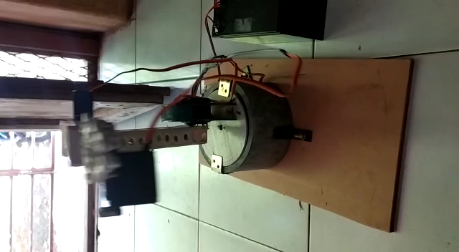
WORKING VIDEO

Slide 31
CONCLUSION
In this project we have interfaced the robot with different kinds of I/O devices and our method allows for storing more programs to enhance more functionality. From our work, we deduced that in comparison to humans, robots can be much stronger and are therefore able to lift heavier weights and exert larger forces. They can be very precise in their movements, reduce labor costs, improve working conditions, reduce material wastage and improve product quality.
This is why they’re very important in industries because the overall objective of industrial engineering is productivity. In this project, the procedure of building an articulated arm robot using a microcontroller (node mcu 32) and servo motors with the help of PWM has been discussed. The building procedure consists of building the kinematic structure of robot, hardware design and implementation, software design and implementation and microcontroller programming. It is important to recall that each servo motor has a different pulse width range where a pulse can have different effects on each servo, therefore it is important to first simulate the system and then implement it accordingly. Different values of the oscillator can cause the system to not operate properly.

Slide 32
REFERENCES
Sanjay Lakshmi Narayan, Shweta Patel, “Position Control of Pick and Place Robotic Arm”, Department of Electrical Engineering MS Rakaia Technology, Bangalore, India.
Design and fabrication of pick and place robotic arm by Dr Sunil Kumar Talakayala, Research gate 343738510.
Nikku, S., “Introduction to Robotics” USA: John Wiley & Sons, 2011.
Haidari, A. M. A., Benachiba, C., Zahir, M., “Software Interfacing of Servo Motor with Microcontroller”, Journal of Electrical Systems (JES), pp.84-99, 2013.
International federation of robotics (IFR), “World Robotics”, Switzerland: United Nation, 2005.

Slide 33
THANK YOU

